Slide 1


Slide 2


Solution
Developing a mobile solution to add real value to our consumers.
Notes:
Implementation

Slide 3

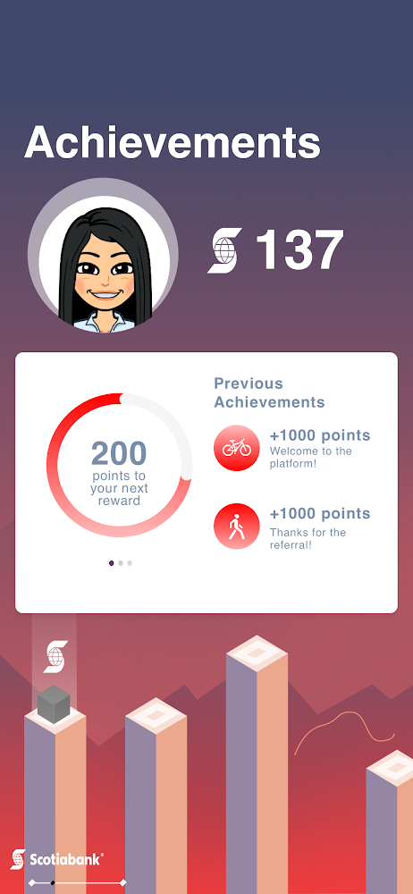
Value and Benefits
Focuses on changing not the P2P payments system itself but the perceptions towards it
Simplifies personal money transfers by making it more natural, social, and interactive
Increased value for Scotiabank personal banking clients and marketing exposure to user-bases of other banks

Slide 4
Implementation Plan
Expansion
Engaging Referral Program
Rollout
Incentive programs: Rewards and free e-Transfers
Proactive
Sustainable
Ensuring security structures and compatibility
Mid 2020
Late 2019
Mid 2019

Slide 5
CONSOLIDATED STATEMENT OF OPERATIONS
FUTURE STEPS
RISKS AND MITGATIONS
SECURITY AND PRIVACY

Slide 6
Consolidated Statement of Operations
Assumptions:
2x growth YoY
7% capital gains
3.7% primate interest rate
Years assuming increases rate of retention + acquisition along with compounded capital gains
Does not include intangible benefits

Slide 7

Future Steps
01
Expansion into other global Scotiabank regions.
02
Develop partnerships with small businesses and merchants.
03
Support additionally functionality through more rewards methods

Slide 8
Risks and Mitigations
01. Slow Adaption
02. Weak Rewards
03. Bad Reviews
Low losses from product launch, can limit marketing to Scotiabank users to gain partial benefits
Evaluate and Modify program by either removing or adding aspects
Recall and Modify the app before a relaunch

Slide 9
Security and Privacy
01
Account Access
Account breach detection and notifications. Need fingerprint/login to access account.
02
Standard Encryption
Safety metrics to protect from fraud in mobile banking.
03
Options for Privacy
Can make payment transfers not visible by public network

